Slide 1
How the Big Book Was Written
District 31 Ol’ Timers Day November 1, 2025

Slide 2

Presentation
Starts in
Minutes

Slide 3

Please be
seated

Slide 4
How the Big Book Was Written
District 31 Ol’ Timers Day November 1, 2025

Slide 5
What We Will cover Today
Select historical highpoints of the early recovery period
Correct some of the myths surrounding the period as told in speech’s, talks, and personal histories
Lay bare the roles played by the key players in A.A.’s development to understand how A.A. was truly created

Slide 6
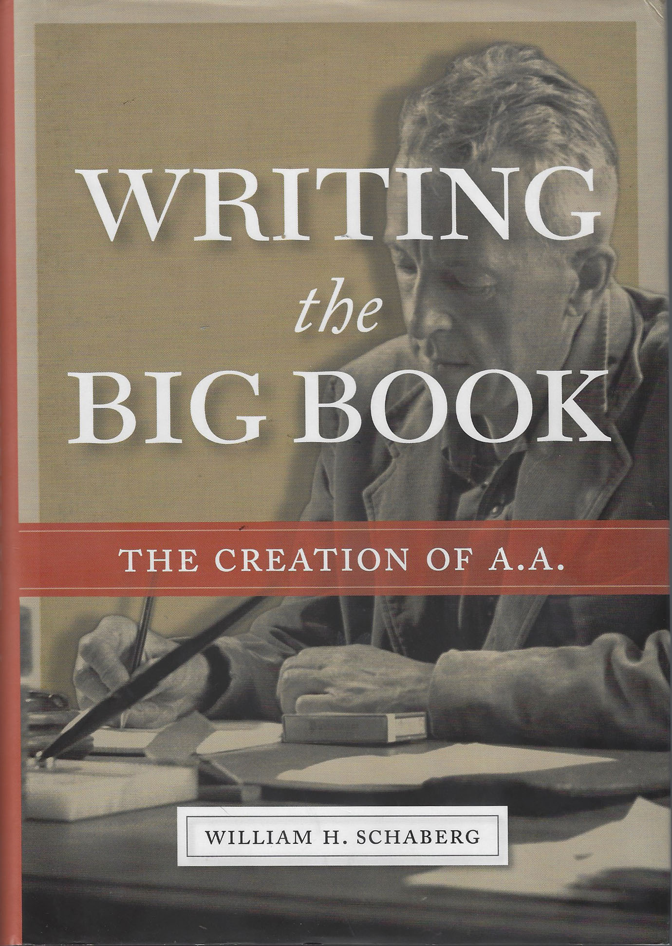
Published in 2019 after an eleven-year study
Thoroughly documented
In complete cooperation with GSO archives and others
Lays bare many myths told
within A.A. today

Slide 7
The author is a rare book dealer and historian
The author uses RAW data vs. stories told many years later…
This is what really happened

Slide 8
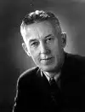
Stories say that 100 people fought, bled, and died to produce the book that we have today.
Bill Wilson was responsible for the writing except for one chapter which he edited.
He was also most responsible for the creation of the many “Myths” surrounding the writing…

Slide 9
Understanding Bill Wilson
Consummate story teller
Bill wanted to convey important messages about recovery
Simple, straight forward, & dramatic…

Slide 10
Bill Wilson – Willful Myth Maker
Stretched facts for emphasis
Let out messy details…
Used deliberate self-depreciation and then credited others…
Avoided uncomfortable facts
Horrible memory for dates

Slide 11
Quick Examples
There weren’t 100 men and women at the time of writing
There were about 70 including wives attending meetings
Bill had been using “100” recoveries for over a year in his promotional and fund-raising efforts…

Slide 12
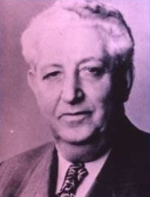
A.A. Number 3 -- Bill Dotson
“Hence, the two men set to work almost frantically upon alcoholics arriving in the ward of the Akron City Hospital. Their very first case, a desperate one, recovered immediately and became A.A. number three. He never had another drink.”

Slide 13
AA Number 3
Bill Dotson was not the first drunk Bill and Bob worked with in 1935
He was the first successful one
Prior attempts with a Dr. McKay and
Eddie Riley were not successful
“Carrying the message” had to have impact…
Saying 1 out of 3 just isn’t the same…

Slide 14
The Kitchen Table
Probably the most famous and most often requested
of Bill’s stories
This is the story of “one drunk talking to another”
and carrying the message…
Ebby’s story about meeting Bill, is quite different
from Bill’s story of the kitchen table…

Slide 15
The Kitchen Table
As Bill tells it:
  Ebby calls Bill and is invited over
  Bill offers Ebby a drink at the kitchen table
  Ebby refuses
  Ebby states, “I’ve got religion”, and he plants the seed for Bill to ultimately find recovery…
  Here’s how Ebby remembers…

Slide 16
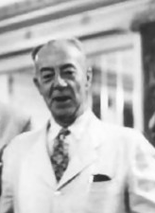
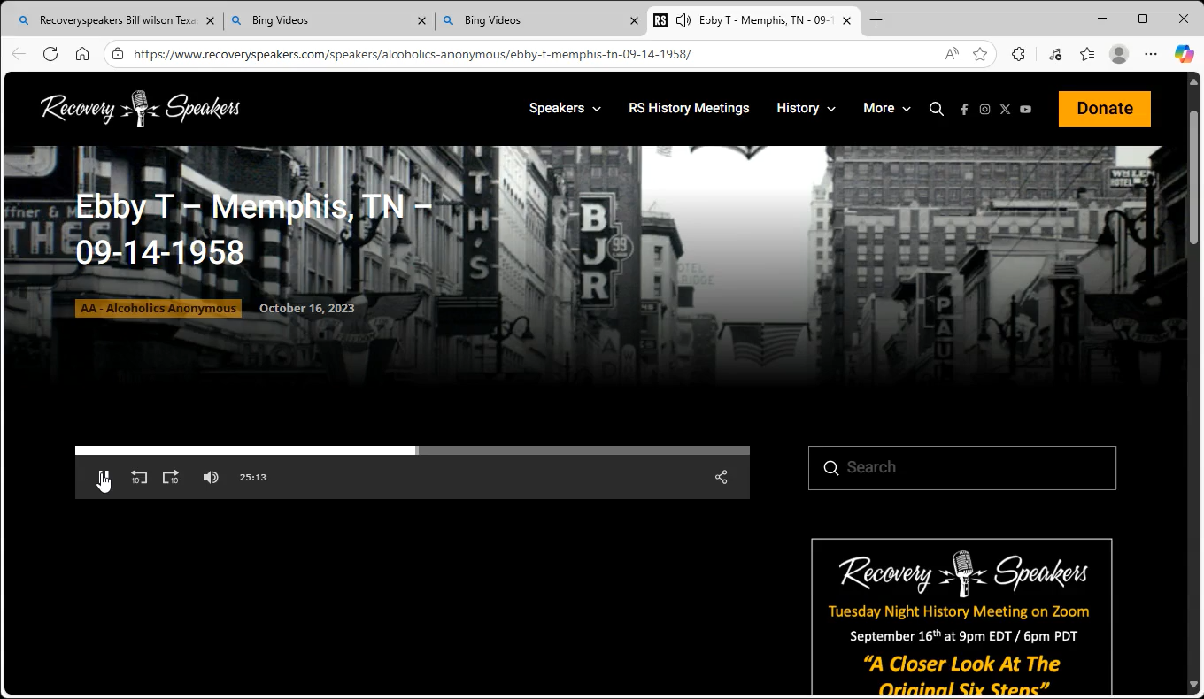
Ebby actually told the story several times…

Slide 17
The Kitchen Table
As Ebby tells it:
  Ebby calls and talks to Lois.
  He tells Lois his story about sobriety
  Lois invites him to dinner.
  When Ebby arrives, neither Lois or Bill was home, but he was invited in by Mr. Green.

Slide 18
The Kitchen Table
As Ebby tells it:
  After everyone arrives, they sit down to dinner including a renter in the home.
  After dinner, they retire to the upstairs and Lois invites Ebby to tell his story.
  They talk for hours.
  Bill accompanies Ebby back to the subway and says, “I don’t know what it is you have, but I want it.”

Slide 19
The Kitchen Table
Ebby’s version is much more detailed and believable
For impact, Bill simplified the story
The message is more important than “facts”…
Even Ebby later remarked that while the story was different, the principle was the same
Ebby also noted that he was the only one sober at the time!

Slide 20
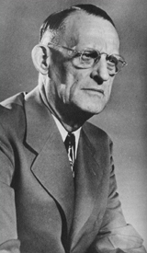
Understanding Dr. Bob
Dr. Bob was quiet, reticent, and reserved
Bill and Dr. Bob never had an argument
Bob would tend to let Bill run off with his ideas
Bob was very secretive, “holding his cards close to his chest”…

Slide 21
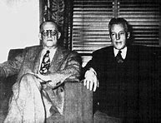
Dr. Bob is considered a saint today within A.A…
Dr. Bob
Known as the King of Twelve-Steppers
Little known outside of Akron, Bill would promote Dr. Bob as he told his stories
Bill would constantly defer the development of A.A. to Dr. Bob and credit him with success…
It wasn’t until 1949 that Dr. Bob was recognized as a cofounder of AA

Slide 22
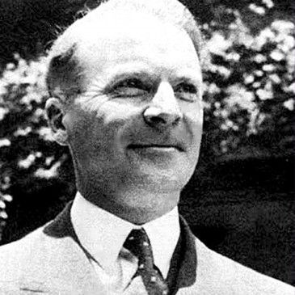
Hank Parkhurst
#2 man in NYC Group…
Aggressive salesman with big ideas
Professional marketer and promoter…
An atheist and pushed for a psychological approach
Provided an office and secretary for Bill’s work…
Constantly involved with making great plans…
Should really be considered as a Cofounder of A.A.

Slide 23
Hank Parkhurst
Provided an early outline for the book…
Was instrumental in getting funding for the book
Convinced Bill to self publish the book
Initiated selling stock leading to Works Publishing…
Arranged and managed the final editing of the book…
“The book would not have been published without Hank’s work.” -- Ruth Hock

Slide 24
Hank Parkhurst
Bill Wilson called Hank a “super promoter-driver” and said he was “the greatest high-pressure salesman I had ever known”.

Slide 25
Hank Parkhurst Ignored
Hank went out only 6 months after the book was published…
Later, he accused Bill of dishonest practices…
Hank never achieved significant sobriety
Bill choose to ignore the inconvenient facts

Slide 26

“Flying Blind” Period in Today’s Discussion
June 1935 through April 1939

Slide 27
“Flying Blind”
During this period, Akron and NYC were participating in the Oxford Groups as their spiritual home, and using it as their means of recovery.
Dr. Bob had been attending prior to his recovery for over a year…
Bill and Lois too had been attending Oxford group meetings and went as far as meeting its key leaders and attending their “house parties”.

Slide 28
Akron/NYC Differences
Akron was more successful in sobering up drunks
Akron was passionately Oxford Group oriented, and you had to “make a surrender” before going to a meeting…
NYC was much more liberal thinking and more open
The small NYC group included some atheist members…
(Bill started “drunks only” meetings in mid 1936,
and fully left the Oxford Groups in mid 1937)…
Akron was suspicious of Bill and his ideas…

Slide 29
Bill’s Oxford Group Issues
  The Oxford Group’s “aggressive evangelism”…
  Excessive personal publicity or prominence…
  Unacceptability of the word “Absolute”…
  The Oxford Group didn’t incorporate the medical side of alcoholism -- relating only to the religious need…
  The coercive nature of “guidance for others” and follow up “checking” to see if it was followed…

Slide 30
Bill’s Great Design
  He wanted to spread recovery everywhere
    He wanted a “sales staff” – “Missionaries”
    He wanted hospitals for detox -- $$$ Funding
    He wanted a book to describe the program
Bill wanted to organize recovery as a new organization independent of the Oxford Groups

Slide 31
Bill’s trip to Akron in 1937 and the “VOTE”
Bill wanted to organize outside of the Oxford Groups
Bill wanted to carry the message outside of Akron and NYC
In discussions with Hank Parkhurst, he had formulated a plan
On his October 1937 visit to Akron, Bill pushed these ideas to Dr. Bob and the result was what is now called the first “Group Conscious”…

Slide 32
The infamous Akron “VOTE”
Bill says that there were 18 people in attendance
The final vote was reported to be 10-8 in favor of Bill’s plans…

Slide 33
The Akron Vote
What Bill never told us about the vote
There were 4 NYC members present plus 3 wives…
We’ll never know where they fit into the count…

Slide 34
Akron Group’s opinion
The Akron group responds
    They argued mightily
    Don’t bring $$$ into the group
    The hospitals are a racket We’ll be accused -- $$
    Jesus didn’t need pamphlets or a book…
  But reportedly, Dr. Bob liked the idea of a book…
  The Akron members basically said, “Go back to NYC and have at it.”

Slide 35
Bill in NYC goes Forward
Major efforts to raise funds overwhelmed the efforts of Bill and Hank
Fund raising was the major effort over the next 20 months…

Slide 36
The writing begins…
Bill’s Story – Chapter 1
Bill made three attempts to write his story in late May 1938
Bill would dictate to Ruth Hock as she typed. Hank was present…
Copies, or partials, of these three attempts exist today
The story as printed in the Big Book even differs from his 3rd try…

Slide 37
There Is a Solution – Chapter 2
Chapter 2 was written in early June of 1938
The immediate purpose of these two chapters was to gain acceptance by contributors, and open the door to donations…
Early versions used the word “religious” 13 times. Final version used “religious” 7 times and “spiritual” 7 times *

Slide 38
There Is a Solution – Chapter 2
Bill has a vision… It is his moment of genius that contains the very essence of the A.A. message of recovery
In There Is a Solution, he states that the alcoholic has
“no defense against the first drink”…
This is the very first time in any study or writing about
alcoholism that this basic diagnosis had been made…
Bill states that problem of the alcoholic is in his MIND.

Slide 39
Bill’s Diagnosis
It was Bill’s miraculous break through that became the centerpiece of virtually every thing he wrote.
In the first 164 pages of the completed book,
this problem is alluded to 77 times!

Slide 40
Bill’s Solution
You can get a spiritual defense which will “restore” you to sanity when it comes to the first drink… *
He repeats the spiritual solution many times in the chapter…
The next chapter Bill will write, “More About Alcoholism” focuses almost exclusively on this diagnosis

Slide 41
Bill’s and Silkworth’s Differences
These different approaches/conclusions can be explained…
Silkworth based his diagnosis on OBSERVATIONS
Wilson’s diagnosis was based on EXPERIENCE…

Slide 42
There Is a Solution – Chapter 2
Defines solution as spiritual while opening up the possibilities
Solution is progressive, pragmatic, democratic, and expansive
Rejects restrictive religious or psychology-first perspectives
And makes no mention of the Oxford Group or any of the Group’s practices

Slide 43
Internal discussion
Hank disagreed with Bill’s approach, and wrote note to Bill with his ideas
His note included the suggestion of using Dr. Silkworth’s letters...
Two weeks later, Hank produced a proposed outline for the book…

Slide 44
Bill’s Story & There is a Solution
Chapters 1 & 2
Chapters were utilized as an entry to raising funds
Presented to the NYC group
Mailed off to Dr. Bob soliciting comments…

Slide 45
Bill’s Letter to Akron
“As a starting point I have, with the help of the folks here, dictated and mimeographed two chapter of the proposed book, one in the nature of an introduction and the second my own story. These I enclose to you together with a rough outline of the contents of other chapters. I imagine you could use this material as a sort of trial balloon, and a starting point for discussion of what you folks out there believe the book ought to contain. Although I have made the beginning, I feel that the completed book should represent the work of many people.”

Slide 46
The Chapters arrive in Akron
Dr. Bob replied, “Looks good”…
Anticipating the response, Dr. Bob never shared them with the Akron Group

Slide 47
More About Alcoholism & We Agnostics Chapters 3 & 4
Publishing talk pushes Bill back to writing
Chapters 3 & 4 were written during September and October of 1938
Continues to show that the problem is “in the mind”, and is
progressive & permanent
Opens up the spiritual side to a “Higher Power”…

Slide 48
Working with Others, To Wives, and The Family Afterwards
Chapters 7, 8, and 9
Chapters 7, 8, & 9 were written during October & November of 1938
All were forwarded on to Akron with very limited exposure
Yes, Lois thought that she should write the chapter to the wives…
Additionally, personal stories were requested…

Slide 49
Hank’s Plan
Hank forms his own publishing company and sells stock
One Hundred Men Corporation is formed (600 shares) @ $25)…
The NYC drunks refused outright...
Soliciting magazines for promotional – Readers Digest…
Hank goes into marketing overdrive with a prospectus…
Eventually, 179 shares are sold

Slide 50
To Employers & A Vision for You
Chapters 10 & 11
Chapters 10 & 11 were written during November of 1938
To Employers was written by Hank Parkhurst – Edited by Bill…
All were forwarded on to Akron. ……..with similar results as only a select few saw them…
At this point, Bill received few criticisms or objections from the NYC Group

Slide 51
Bill finally gets to the most important parts
Chapters 4 & 5 - The Steps and Into Action
Written in December 1938…
The Steps were outlined first, and then the Chapter was written
Finally, discussions in NYC and argument in the office…
The “Higher Power” issue…
In Akron, Dr. Bob continued very limited distribution with no feed-back to Bill

Slide 52
The 6 Steps Issue
6 steps moving to 12 was entirely Bill’s creation in a talk over 10 years later
A formal 6 step program never existed or was practiced in the Oxford Groups…
In the original stories at the back of the book, there is no mention of steps…

Slide 53
Hank handles the Editing
January through March 1939
Throughout this period many editing changes were made
Two professional editors were used
  Tom Uzzell for overall format
  Janet Blair for text editing
The book size was reduced by over 30%
Changes were made up until printing…

Slide 54
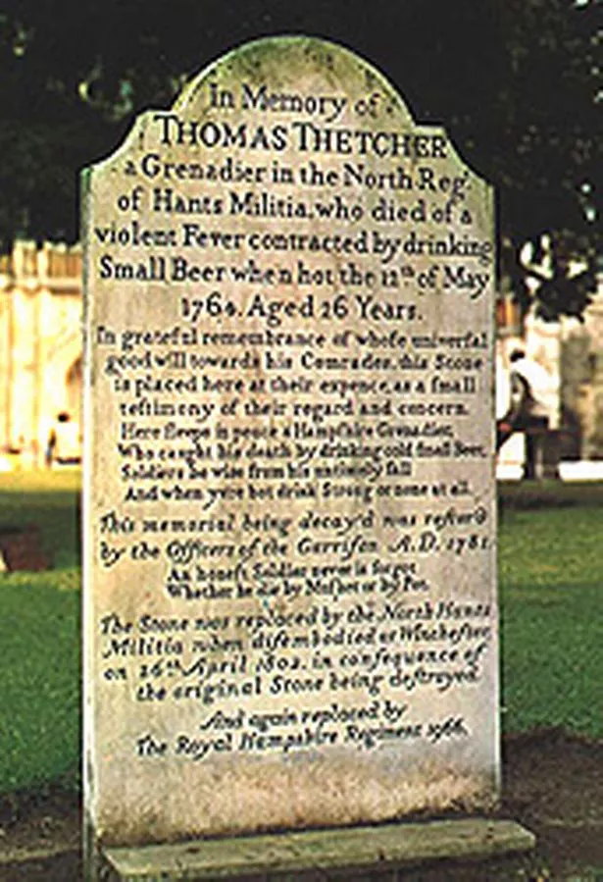
Editing Errors
Editing caused some errors & misunderstanding
Bill’s story starts with his visit to Winchester Cathedral and the poem of the Hampshire Grenadier…
“That war-time day in old Winchester Cathedral…”…
The editor had deleted the first 7 pages of Bill’s story…

Slide 55
The Multilith Edition
In mid February 1939, about 400 copies of the book were prepared in Multilith format…
Mailed out to various people to solicit comment, promote the sale of the book, and additional stock…
Comments from a Dr. Howard…
But Hank also contributed with an addition to Bill’s Story
Hank wrote and inserted 4 paragraphs that became basic keys to the program…
Akron received copies

Slide 56
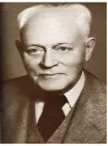
The Multilith Suprises
“The Doctor’s Opinion” appeared as the first 4 pages
No prior documentation for this chapter…
It appears to have been added in the final moments as Bill’s Story, also starts with page 1

Slide 57
A Forward was also added
Also included was the Forward…
Apparently also a last-minute addition…

Slide 58
A.A. Comes Together
A month after publication of the Big Book, the Cleveland group broke away from Akron, called themselves Alcoholic’s Anonymous, and started using the Big Book as the path to recovery…
Slowly, the basics of A.A. as we know it today, spread even in Akron.
Finally, in December of 1939, the Akron group broke away from
the Oxford Groups.

Slide 59

About 4650 copies were printed.
By 1955 over 300,000 had been distributed.
By 1973 over a million books had been distributed.
Today, there have been over 37 million copies of the
A.A. big book distributed.
The book made Time magazine’s list of 100 most influential books ever published in English, and, according to the Library of Congress, is one of the 100 books that shaped America.
On April 10, 1939, the Book is Published

Slide 60
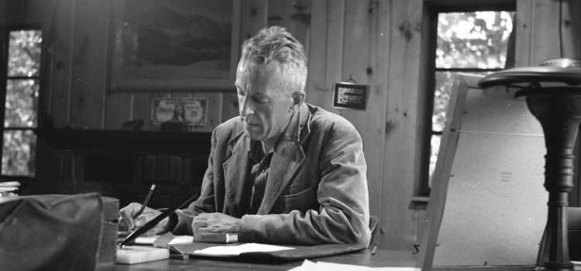
Creating A.A …
Bill had a lot of inputs and suggestions as he wrote the book. But in the end, it was solely his creation.
Through writing and publishing, Bill originated and created the A.A. program as we know it today…
He designed the program to mirror HIS recovery and his ideas…
It is not a book about “How WE recovered….”
Bill was not a great historian, but he was a man of great vision.

Slide 61
We’ve heard….
Not only how the Big Book was written, but how all of A.A. was created
Thank you for your attention today
It’s time for questions and comments…

